Slide 1
More Style With HTML
Peter Blanchfield

Slide 2
We already started doing this
As a reminder
We learned about
Text colour
Font-family
And even a special effect of a shadow

Slide 3
So here is roughly what we did
We made a repository on GitHub
And then made a web page on local host with nothing in
Then we added a title in the header
And some <h1>, <h>, <h3> and <p> text
Then we added some style elements

Slide 4
What does CSS stand for
Someone already told us
Cascading Style Sheets
The are good as ways of keeping a consistent style over a whole website
Rather than having to style each page individually
They don’t stop you adding special things where needed on pages
They just remove the work if you want the same basic style on each page
From HTML 3 you could add styles like new fonts but it was hard work if you had a lot of pages

Slide 5
We already saw the syntax some time ago
Basically you say the type of area or text or whatever then
An opening {
The property :value combination
As a list (it could all be on one line if you want!)
Each combination ends with a ;
Then the }
The type or area is called a selector in CSS speak
There are simple ones like
h3 and p that correspond to headers and paragraphs
This can then be used to affect a specific element for a type using an index

Slide 6
* Is the universal selector
* {
text-align: center;
color: magenta;
}
Will make everything centre aligned and magenta!

Slide 7
If a certain set of selectors have the same attributes
For example all of h2, h3 and h4 were to be white and centred then we group them
h1, h2, h3 {
text-align : center;
color : white;
}

Slide 8
Where do we put the CSS
So far its been internal – in the header
We can also put styling in line
In the tag itself
For example
If we add
<body style="background-color: black">
The internal definition is overridden
(The one in the header)

Slide 9
We could also put the style into a separate sheet
We have to define it and link to it
In visual studio we can add file and choose a style sheet
Then add the link to it
Internal styles will overwrite it
And inline styles will overwrite this
But just now I have only got style
Defined in SimpleStyle.css

Slide 10
Just copied the internal one

Slide 11
So here I am

Slide 12
Now I am going to push my development

Slide 13
Add comments
Our very minimum level of documentation is to comment
We should do this even in the style sheet
The html comment is surrounded by
<!-- then the comments -->
We comment the css within /* comments here */
So many styles to remember
You need to think about maintenance even as you develop
So comment anything that is not completely clear

Slide 14
Colouring
We can colour whole body with one background but we can also colour specific parts with a different colour

Slide 15
Up to now we have seen background colour
But there is also
background-image
background-repeat
background-attachment
background-position
Background-color does have an opacity value
That sets the transparency
This acts the same way as the ‘a’ value in rgba – used in colouring one of my backgrounds earlier
Background-image is fairly obvious
background-image: url(“image.jpg”); /*or whatever type of image*/
Be careful what you use

Slide 16
I used a new branch for this
I am going to try something that might not be good.
Its always a good idea to make a new branch to try something
Some backgrounds just don’t work so well.
Though most of this one is not really good for other reasons as well.

Slide 17
Is this one any better?

Slide 18
Or maybe this

Slide 19
Some (many) backgrounds are only meant as headers
You could have a small image that you want to repeat across or down the page
Say as a banner

Slide 20
If we just use it as a background we get

Slide 21
The image repeats horizontally but also vertically
Adding
background-repeat: repeat-x;
Under the background image
Statement changes the output
So that there is no vertical repeat

Slide 22
Similarly
This image

Slide 23
Produces

Slide 24
Adding background-repeat: repeat-y; Produces

Slide 25
And background-repeat: no-repeat; Produces

Slide 26
Of course we could do the same
For any specific section or division in the pages

Slide 27
Let us make a more fun image for the background
And make it stay in the right top as the page scrolls
To demo this I might need to add a bit of video or something
Here is my code version 1:
<title>CSS Background Example</title>
<!--<link href="simple.css" rel="stylesheet" type="text/css">-->
<link rel="shortcut icon" href="../images/favicon.ico" />
<style>
body {
background-image: url("sparkle.png");
background-repeat: no-repeat;
background-position: right top;
}
</style>

Slide 28
As it is the picture does not scroll when I scroll down

Slide 29
Let us make a more fun image for the background
Adding background-attachment: fixed; makes a lot of difference
Here is my code version 2:
<title>CSS Background Example</title>
<!--<link href="simple.css" rel="stylesheet" type="text/css">-->
<link rel="shortcut icon" href="../images/favicon.ico" />
<style>
body {
background-image: url("sparkle.png");
background-repeat: no-repeat;
background-position: right top;
background-attachment: fixed;
}
</style>

Slide 30
So now it follows the scroll bar down

Slide 31
Video proof

Slide 32
We can also do the same on the left
<style>
body {
background-image: url("sparkle.png");
background-repeat: no-repeat;
background-position: left;
background-attachment: fixed;
/*I had to move the text to the right by adding a margin*/
margin-left: 400px;
}
</style>
Notice position is left not top left
You can do top left

Slide 33
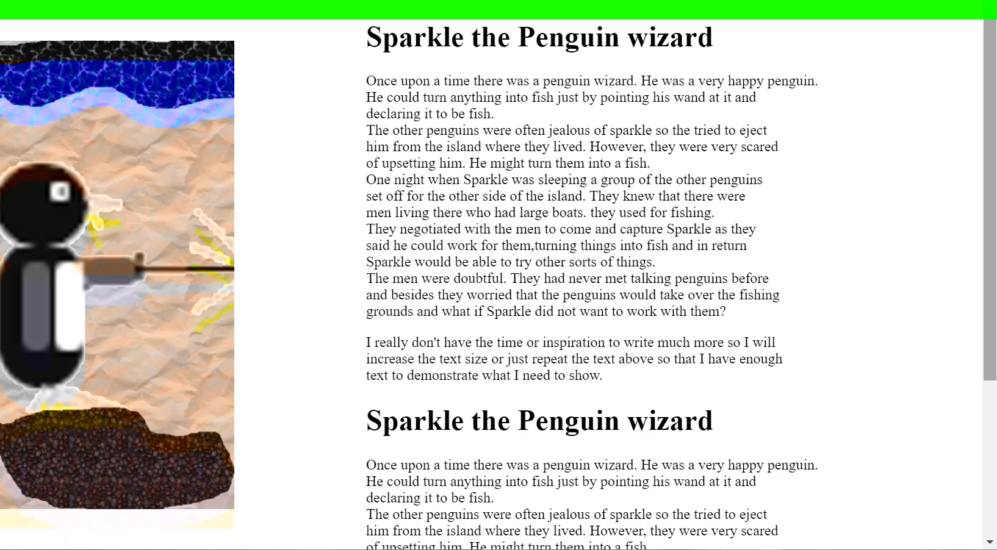
Non scrolling left image

Slide 34
We can do this with the background shorthand
<style>
/*
shorthand order
background-color
background-image
background-repeat
background-attachment
background-position
*/
body {
background: #ffff url("sparkle.png") no-repeat fixed top left;
margin-left: 400px;
}
</style>
But you do have to remember the order

Slide 35
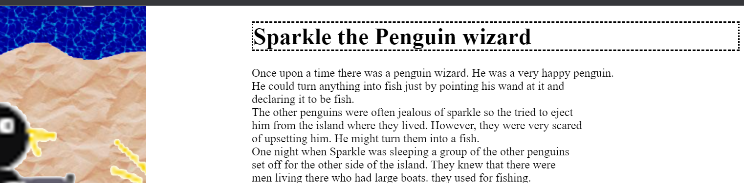
We already saw you can put borders on elements
h1{
border-style: dashed dotted dashed dotted;
}

Slide 36
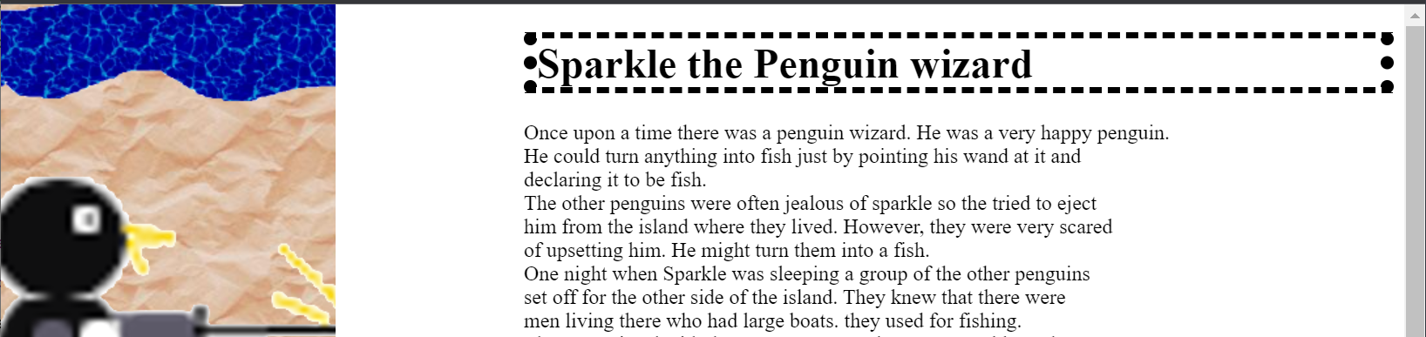
We can use multiple elements
h1{
border-style: dashed dotted dashed dotted;
border-width: 5px 10px; /*horizontal then vertical */
}

Slide 37
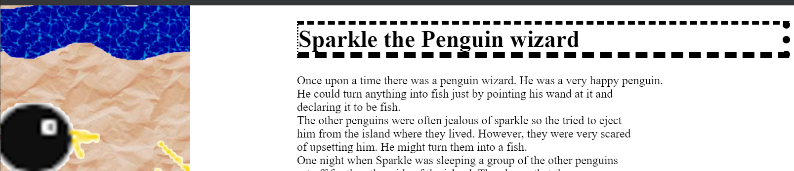
In many ways
h1{
border-style: dashed dotted dashed dotted;
border-width: 5px 10px 8px 2px; /*top right bottom left */
}

Slide 38
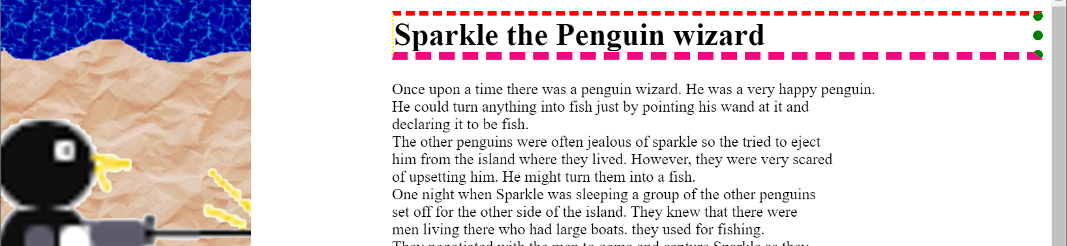
In many ways. Just because you can doesn’t mean…
h1{
border-style: dashed dotted dashed dotted;
border-width: 5px 10px 8px 2px; /*top right bottom left */
border-color: red green #f0087f yellow; /* red top, green right, blue bottom and yellow left */
}

